Slide 1
Flipping Training: new ideas
Nicola Sales
University of Salford
Notes:
Worked on Analytical and Research Skills, known as its acronym for short ….. Module (I’ll give you a moment to work that out!)

Slide 2
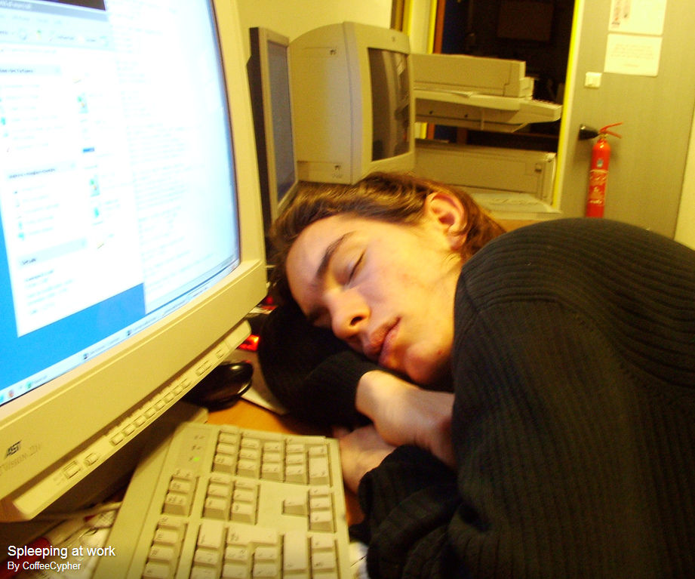
Engagement
Motivation
Achievement
Notes:
The learning outcomes of the ARS module intended to equip students with all the necessary research, critical thinking and study skills they will need for their degree.
However there were problems resulting in poor student feedback and low attendance - often as low as only 10-15% attending sessions.
lack of knowledge transfer by students from this module to their other studies.
Trying to teach a skills module in a lecture room, resulting in librarian led training and a passive student experience.
All this added up to meaning our training had to change
We did run practical training sessions in the library but based on the low attendance at lectures there wasn’t much uptake for the practical sessions.
The practical sessions involved students replicating searches following tutor demonstrations, navigating library resources on their own computers.
Participants followed me on automatic-pilot and although they achieved search results in the classroom, they weren’t retaining the knowledge or transferring it to their own research.
So, I was tasked with looking into new ways we could deliver this training that would engage service users, be effective and interactive and help encourage application of knowledge to their own research problems outside of the training room.

Slide 3
Flipping the training room
Image courtesy of http://news.icschool.co.uk
Notes:
flipping the training room or flipping the classroom as it is more commonly known, came to my attention after researching different training methods and reviewing their potential effectiveness for legal research training.
In 2000 a guy named J Wesley Bake presenting a conference paper called ‘the classroom flip’ where the phrase ‘flipping the classroom’ was coined.
He also describing how flipping the classroom allows the trainer to become the ‘guide on the side’ rather than the ‘sage on the stage’
It’s a popular teaching method in the USA, used initial with schools to teach things like maths, science equations but its growing in popularity with schools over the pond here. Salford is one of the first universities to use it in the UK for teaching information skills.

Slide 4
Trainer led
Participants observe
Demonstrations
Follow guided instruction
Participants perform training activity
Feedback discussion
Flipped training
Training content studied prior to attending training
Training session is participant led
Traditional training
Problem based learning activities
Discussion
Participants receive support and guidance
Notes:
So what is flipping the classroom as a training method?
In essence using the flipped training methodology means participants study content before coming into the training room. In a flipped scenario this training is short and bite sized, In libraries this content often covers the ‘how to’ element of performing research but it can also be used to introduce concepts and ideas which can form the basis for a discussion or task in a face to face training situation.
Usually this learning content is delivered online so you can study at your own pace and when it is convenient. The content can be videos, guides, podcasts, screen casts or anything you have in your imagination!
AT SALFORD:
Flipping has worked well at Salford as the training is embedded in a module. I was able to flip a lecture and 3 seminars and having the support of the academic team was essential. The practical activities I used in face to face sessions focused on topics students were studying in their core academic modules so they saw the transferability of the skills they were gaining.
For example the activity for the IT seminar was based on finding information for the public law seminar topic the students needed to prepare for the following week. Linking up with other subjects in this ways allows the students to see an immediate relevance of the need to conduct research in relation to their academic modules. Having relevant tasks engaged the students with their work as they could see the benefit for themselves. There were many pleased students during the practical research tasks searching for cases, legislation and journals in the library during the second week of term as they found two articles they needed for Criminal Law the next week, one student commented ‘I had no idea where to start and now I’ve got it, I won’t be worrying now!’
By linking their activities for the lecture and the seminars to their other academic modules the programme leaders in the law school were on board with the new style of teaching and actively encouraged students to do the preparation work by reminding them of the benefits of attending the sessions.
It is important to remember that it is a blended learning approach and it is important to keep the face to face element of training.
that the flipped classroom not …
where trainers are replaced by videos and podcasts, it is not an online course, it is not about leaving people to study with no structure or in isolation, nor is it where you use face to face training time for students to study the learning content on a computer whilst the trainer circulates the room.
Any contact time is used to build on the knowledge gained during preparation.
Face to face sessions have to contain an element of discussion so that you as a trainer can answer any questions, queries and ask for further clarification or explanation if points from the preparation content are not clear.
Its vital that sessions need to provide opportunities to apply and test out practical skills as this helps consolidate what has been studied.
Problem based learning activities are ideal for this as individuals can complete tasks with the course leader on hand to help support and guide them through the processes of research and assist with queries.
At the end of a training sessions there should always be the opportunity for discussion on how the session has gone, have common queries and themes arisen, this is a fantastic opportunity for peer support so course attendants can pass their knowledge to each other if they have found a solution or easier, quicker way to do something.
…. As I mentioned earlier the phrase ‘guide on the side’ comes into its own here as individuals drive their research using their knowledge.

Slide 5
Academic experiences
Notes:
I had no idea if my students would engage with it – I’ve never given them control for their own learning in this way before. I must admit despite all the reading and research I had done I had low confidence in the students doing the work and then participating in the sessions. I had read many articles saying, they will do it and they participate but I didn’t believe them – I think this is a justified feed after the experience I’ve had in the past years staring at blank faces when I’ve asked questions in a traditional teaching session!
The first session I delivered was a lecture - roughly 70% of the students had done the preparation work, I was hugely relieved, these students were able to hit the ground running with the search strategy activates I had prepared for them to do.
It was the nosiest lecture I have ever taken, students thrived on taking ownership of their work, they participated in discussion and were willing to share their work with the rest of the room, allowing others to contribute, tips and ideas for improving their search strategies.
As a trainer the most daunting thing for me was walking into the lecture room with only 4 PowerPoint slides and a collection of worksheets to fill the hour long lesson. I had the theory in my head but I didn’t know how it was going to flow in practice if they didn’t engage. I kept thinking that my fall back would be a demonstration – but it wasn’t needed.
An important rule that I set and adhered to was not to recover what the online prep had covered for those students who hadn’t done the work before coming to the session.
For those students who hadn’t prepared who had a phone or tablet I suggested they could log onto the videos and watch them during the first part of the lecture to quickly get up to speed, those without technology I encouraged them to review the videos afterwards and join in with the group work so they could learn off their peers. Going back and recapping at length would have alienated those who had done the prep and the relevance of doing the prep would have been lost if I had repeated it in class.
At the next seminar only 10% of the group admitted to not doing the prep. This appears accurate from the dynamics of the group discussion and group learning activities. There will always be someone who doesn’t do the preparation but many who started off not doing the prep feedback that they would do it next time as they didn’t like the feeling of being behind everyone else.
The impact on attendance to my sessions was huge, in the academic year 2012 to 2013 as I mentioned earlier, attendance was limited to 10-15% of the cohort session by session, Using the flipping the classroom technique, this rose to a consistent attendance of above 91% for each group.
The standard of questions they students asked me in the library has been noticeable higher, as well as the number of students dropping into ask me things, many students commented in feedback that they felt they had the confidence ‘to have a go’ at using a database even if they had never seen it before.
Those students who achieved a good pass rate in the Analytical and research skills module also achieved well in other core modules.
Feedback from academic staff included comment that the standard of referencing and sources used was noticeably higher with this first year intake than in previous years.
Student feedback showed they enjoyed the sessions, especially the interaction, discussion and control they had over their learning.

Slide 6
Flipping training in practice at Salford: Blackboard VLE
Notes:
I used Salford’s VLE, Blackboard and created Individual Learning modules for students to access prior to each session. My students knew then that all the materials they needed were in one place and as they were used to accessing Blackboard regularly they didn’t have to go off hunting somewhere new.
If you are doing a suite of training over a period of time, as I did over a period of 3 months, it is a good idea to release pre-study materials shortly before the specific training session so people don’t start speeding a head or overloading them with information, one of the things that helps make flipping successful is providing information when it is needed and in context.

Slide 7
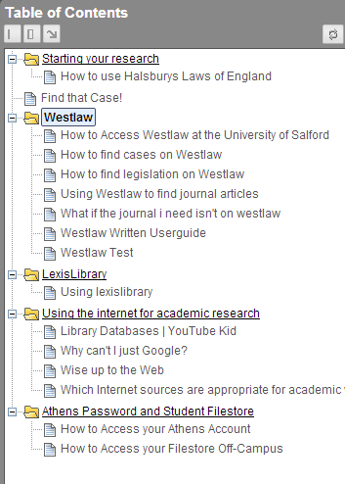
Decide on your content
Notes:
You will then need to decide on which content is appropriate to your Audience
decide how much time you want them to spend studying – if you have a busy fee-earner you may want them to watch one video for three or four minutes, in academic environments you may have the potential for them to study for longer.
As my training was in a academic module I was able to provide more prelearning content, I aimed for 40 minute preparation. In reviewing the experiences I and my students had last year, I know that I gave too much information and will be tailoring each section of learning content down to what they actually need to know. I will be basing these changes on statistics from the most visited pages as well as student feedback and the type of queries that seemed to come up time and again in each session..

Slide 8
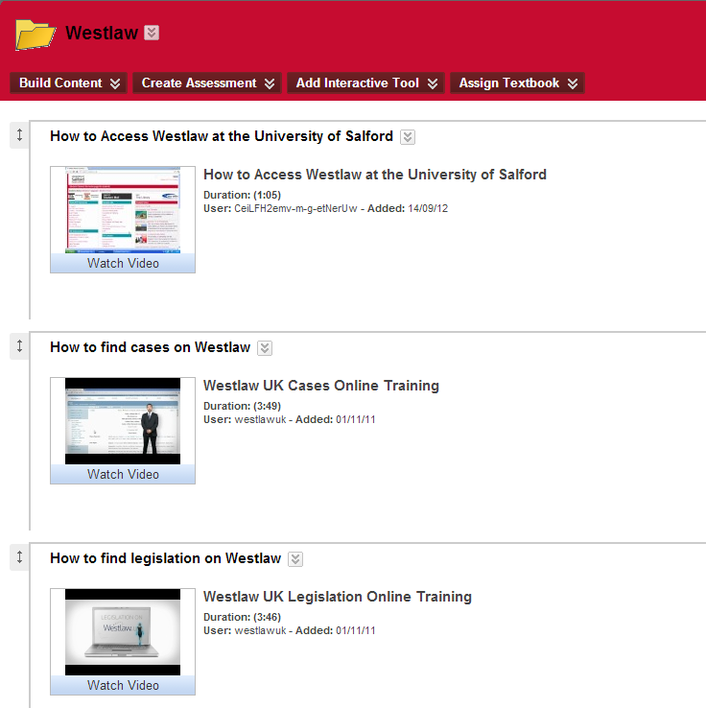
Create your content
Notes:
You need to decide how to create your training,
If there was reusable content already available then I used this, I didn’t go inventing the wheel. This meant I could then spend my time producing materials for content that wasn’t currently available such as producing videos on how to reference materials using the OSCOLA referencing style. I found there was lots of excellent pre-existing materials and many of the database providers have training videos online that you can either embed or link to.
I’ve used a combination of voiced over PowerPoint, prezi presentations, I made videos using screen casting software and hosted them on a You Tube channel I created for this purpose.
In all it took me around 3 months, working part time to set up my whole flipped training, but I could produce one screen cast video in a morning or afternoon. The first one will always take you the longest but you quickly become expert.
In the cash strapped world we find ourselves my first videos were made using free software such as Jing for image capture and screen capture recordings. Once I was able to demonstrate the usefulness of the videos I moved on to the licenced Camtasia software, which offers a higher quality finish to the videos however Jing was fantastic for quick, how to videos.
The best piece of advice I received about making online content was to keep it short and simple, deliver short, snappy bites of training so not to overwhelm learners, just provide enough to get started so you can build on knowledge in the training room.
If you have great web design ideas, go for it and be creative if you want but its not a necessary skill!

Slide 9
Short videos 3 – 4 minutes
Repurpose content
Use free software
Natural voice
Focus learning content
Time release learning
Resist repetition
Remember its more than just videos
Create relevant tasks
Be flexible
Image courtesy of iabusa flicker.com
Notes:
Flipping can be successful in the right context, content and if you have appropriate activities to support the flipped model once in the training room.
Here are my top 10 things to think about if you want to flip:
individuals attention span isn’t long for videos and the aim is not to overwhelm them with knowledge. By all means, create a series of short videos for people to watch covering specific topics – don’t try and do one video with everything in! 4 minutes is a good aim
If it already exists under creative commons, jorum, you tube or prezi for example save yourself time and energy and link to the existing content, some databases have great training suites on youtube made up of short videos.
In the current climate being able to do something for nothing is always preferable, have a look at the free software out there to use. Powerpoint can be used to record voice if you have a microphone, you could then upload a short presentation into youtube and send the link round to people – y u don’t need fancy web design skills to get going.
If you haven’t recorded anything before, and those of you have record something in this room before, will relate to me when I say that recording and hearing your own voice is a weird experience, try and use your natural, talking voice – it takes a few goes but this does become more instinctive!
Limit your content, don’t’ try and tell them everything, produce tailored focuses small sections of content.
If you can, release content when its needed rather than in one go to avoid information overload if you running more than one session.
Stick to your plan and resist repetition, resist repeating the pre-learning content demos during contact time (unless of course everyone is confused!) if anyone has missed it they can catch up later and just have a go a tasks, they will retain more or can work with colleague who has done the prep! If you start demoing for one or two people you will loose the others.
You also need to work with the principle that flipping training is not just putting up videos online or sending them around via email and leaving individuals to watch and learn from them. Flipping does involve training materials available prior and after sessions but the face to face element is still a vital part of the process to consolidate and build on learning. Flipping does not aim to reduce training or staff involvement it redirects staff from leading sessions to facilitating the learning environment.
As far as possible make the tasks they will do in the practical face to face sessions as relevant to your trainees as possible, so that may be linking to a piece of academic work or a typical focused research task new trainees may be asked to perform in their first weeks in a new organisation.
And be flexible, be prepared to adapt in response to how the discussion and tasks go so you can tailor your training sessions to the needs of the people in the training room.

Slide 10
Nicola Sales
n.sales@salford.ac.uk
@nicolasales
Notes:
Flipping training may not be for all but these are my experiences and this is the knowledge I have built up from research and from implementing this training strategy.
I hope that you have found this useful and interesting. I hope that listening today may have prompted some of you to be thinking about how you could incorporate these ideas and practices into your organisation if you are these are my contact details, you can ask me questions in a moment but you may find you have questions when you are back at work, if you do, please get in touch and I’ll be happy to have a flipping discussion!
Thank you very much for lisenting.
[keep incase needed]
The question I get asked the most is … how do you get people to do the study beforehand?!
In an academic environment this is made slightly easier as students are used to doing preparation work for other seminars so this bought ARS inline with their other academic modules. For those offering bookable, voluntary sessions you could encourage preparation as a prerequisite for the course, if you are deliver pre-learning content via a VLE a short course you could specify this needs to be completed before the training day and monitor logins and completion data.
Relying on people to do the work before they come is a scary thing!

Slide 11
Image courtesy of www.weareteachers.com
Notes:
As with all training methods there are Pros and Cons to flipping your classroom, I have experienced all of the things I am going to talk about now, it is hard to find a training method to suit all course participants, and despite my nerves at flipping my classroom it has proved to be an excellent training method in the right place and context.

Slide 12
Notes:
Some of the plus points of flipping training are:
Individuals own and control their own learning and take responsibility for it
As Content can be learned before training, individuals can study at their own pace, time and location, they can study it as much or as little as they feel they need, if they don’t understand it they can watch it again without having to admit it or without feeling lost as they may do in a training session which is moving at too fast a pace. People don’t get left behind.
People know the broad context of the training before coming to your session, so they have appropriate expectations
Content can be made available after training to support learners
Flipping makes for lively training as people engage with the process
There is increased interaction between trainer and the group through discussion and review
As time is not spent doing demonstrations you can spend time guiding and facilitating trainees through the process, peer to peer learning occurs,

Slide 13
Notes:
On the other side however,
Letting go of the ‘I have told them notion’! There is nothing more scary as a trainer then letting go of the ability to say ‘I know I’ve told them’ even if they haven’t remembered you can tick the box confidently to say training has been given! I didn’t sleep the night before I did my first flipped training, I was imagining awful scenarios of not one of my students having done the preparation and staring at me blankly for the whole hour!
Putting up too much content – this is something that is very easy to do as we find it hard to step away from regurgitating everything that we know especially if we think this one or two contact times is our only opportunity to tell them what we think they need to know. I am definitely guilty of this and in reviewing my flipped training roll out from last year I know I need to pare down my online learning content for September 2013. I need to focus on what training is needed, not what I want to tell them!
Access to software and technology to create learning content and having a suitable place to host it may raise issues.
Having the time to create learning content my be difficult – you have to commit to planning a flipped training session well in advance to ensure everything is created, released and promoted to your audience.
If this is a new training method for you and your audience, you will all need to acclimatise them to the new methodology

